Slide 1

DRAFT
Commercial Management of
Mid & Back Office Services:
        Enron’s transactions with others
        External Clients with specific service requirements
April 2001

Slide 2

Agenda
Internal Structure
Origination
Operations Pricing Desk
External Approach to Market
Next Steps

Slide 3
Internal Structure – What has Changed?
Process
Pros
Cons
Before
Deals done without pricing from operations desk
Services offered without energy operation’s knowledge
Hidden costs may overwhelm profitability
Inconsistent service levels
Deal components not quantified
Now
Deals requiring pricing and signed DASH from operations desk:
  Asset Management transactions
  Acquisitions
  Any deal with a service component (regardless of the underlying commodity commitment)
  Any commodity deal with non-standard delivery mechanisms
Measures true profitability
Increased level of service
Coordinated approach to the marketplace
Consistent pricing methodology
Notes:
Originators will market the services to customers.
Originators will get pricing from a desk before serving prices to a customer.
ENE systems support personnel will continue to support the back office systems.
EnronOnline help desk will provide support for customers.

Slide 4
Steps in Structuring a Deal with Operations Component
Identify customer needs
Work with domain experts from operations desk to ensure deal compliance
Determine deal terms and specifications with domain experts and customers
Receive offers from desk
DASH signed by ENE management
Contract
Notes:
Originators will market the services to customers.
Originators will get pricing from a desk before serving prices to a customer.
ENE systems support personnel will continue to support the back office systems.
EnronOnline help desk will provide support for customers.

Slide 5
Overview of the Operations Desk
Focus of commercialization:
Factors affecting mid & back office pricing:
Operationally intensive transactions
Asset management deals
New and renewed deals (?)
Cost analysis of mid & back office:
Process cost analysis
Activity cost analysis
Efficiency & productivity analysis
Trend analysis
Impact analysis
Enron Americas
Natural Gas
Power
US and Canada
EGM
Crude / Products
LNG
Coal
Emissions
Weather
EIM
Pulp & Paper
Lumber
Steel
EEL
Present
Future
Notes:
Originators will market the services to customers.
Originators will get pricing from a desk before serving prices to a customer.
ENE systems support personnel will continue to support the back office systems.
EnronOnline help desk will provide support for customers.

Slide 6
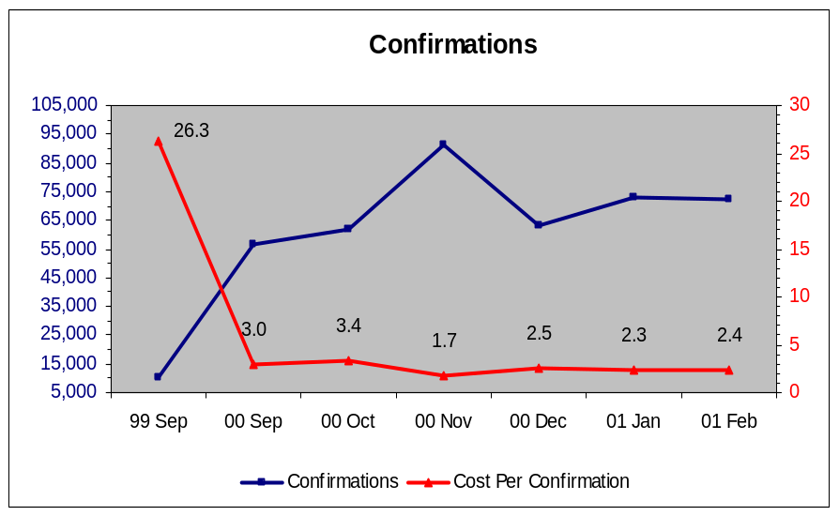
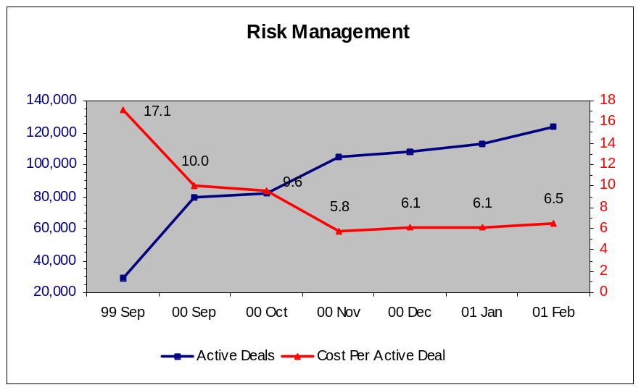
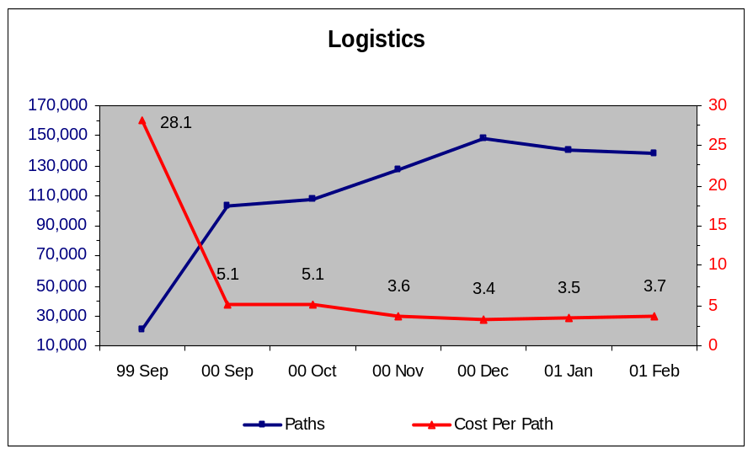
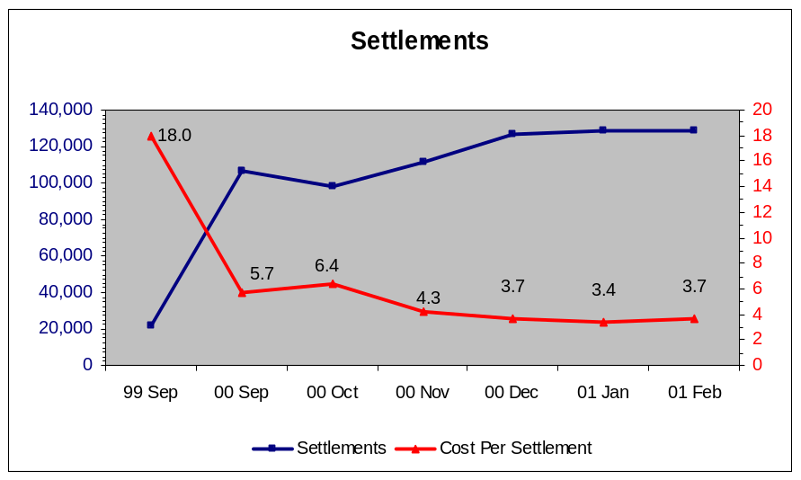
Operations Desk Pricing Example :

Slide 7
How will the Operations Desk Work?
Deal Data
Customer
Back Office
Services
Operations
Desk
Requirements
Price + margin
Deals
Originator
Price
Back Office Desk controls pricing levels
Originators receive a transaction price
Keep excess over prices quoted
Charged back for selling under price quoted

Slide 8
External Market: How will Origination Work?
Originators
(ENA & ENW)
Back Office = Commercial
  Pricing comes from a desk
Multiple distribution channels:
  ENA Originators : existing relationships
  ENW Originators : New / Direct relationships and business development
Distribution channels will work with domain experts toward closing the deal
BO
Desk
Notes:
Originators will market the services to customers.
Originators will get pricing from a desk before serving prices to a customer.
ENE systems support personnel will continue to support the back office systems.
EnronOnline help desk will provide support for customers.

Slide 9
Support and Contacts
Originator
Originator
Originator
Originator
Originator
Structuring/Pricing:
Todd Busby
Pricing:
James
Scribner
Physical Gas:
Bob Hall
Bob Superty
Financial Deals:
Leslie Reeves
Thresa Allen
Technology:
Support &
Development

Slide 10
What Commodity Types are Supported?
Initial mid and back-office services for third party customers will support:
  Physical gas
  Financial gas
  Physical Power
  Financial power
More product-types will be supported in the future

Slide 11

Why this Service and Why Now?
Addressable Market is
$419,000,000
Monetization opportunity brought about by our systems which allow:
  Scalability
  Best-in-class performance
  Efficiencies across the board
Marginal
Cost Per Transaction
(Indexed)
100
25
1999
2000

Slide 12
Approach to Market
Segment:
The market is segmented by transaction volumes
Target:
The target market is the middle and lower tier of the market
Positioning:
Best-in-class systems
Allows firms to concentrate on their core operation
No maintenance or infrastructure expenses
Reduce development risk
Keep up with changing technology - upgrade with Enron
Notes:
Approach to market
Pitch
Service Level Agreements
Pricing Methodology

Slide 13
What are the Services?
Initially, services offered will include:
  Deal capture and confirmation services
  Reporting
  Logistics and scheduling services
  Volume management (Actualization)
  Settlements (cash collection / payment and reconciliation)
  AR/AP accounting entries
Future offerings will include other bundled services, e.g. risk reporting , etc.

Slide 14
What is the Process?
A New Deal
Each new transaction goes through this process
  This includes EOL and non EOL deals
    This applies to all physical commodities, Physical Gas, Physical Power, etc . .
        Financial Transactions skip
        Logistics & VM
Trade Capture
Deal Compliance
Risk Mgmt
Logistics
Volume Mgmt
Term Deals repeat the process
Each active deal repeats this process (excluding trade capture)
  An average Physical Gas term deal is active about 9 months
    An average Financial Gas term deal is active about 2 months
      An average Physical Power deal is active about 4 months
Cash Mgmt

Slide 15
Next Steps
Attain buy-in from relevant commercial teams.
Create an effective marketing plan.
3a. Complete service level agreement (SLA) template.
3b. Complete deal approval sheet (DASH) template.
4. Integrate commercialization of mid and back offices into the present structuring / origination / deal analysis process.

Slide 16
Appendix
Notes:
Originators will market the services to customers.
Originators will get pricing from a desk before serving prices to a customer.
ENE systems support personnel will continue to support the back office systems.
EnronOnline help desk will provide support for customers.

Slide 17
Market Segmentation
Number of Companies in Current Market Segments:
Company Type
Gas
Power
Marketers
843
266
Producers
799
140
Large Buyers
496
116
LDCs
278
0
Brokers
145
78
Govt. / Municipal
10
544
Total
2,571
1,144
Future Market Segments: Other commodity types, i.e. metals, crude, etc.
Data Source: OPIS Directories

Slide 18
Marketing the Services
Service level agreement:
  (Points to be filled in as they are determined)
Notes:
Approach to market
Pitch
Service Level Agreements
Pricing Methodology

Slide 19
How will Support Work?
Two levels of customer service support:
  Level I: EnronOnline Help Desk
  Level II: Enron Operation Services
Notes:
Originators will market the services to customers.
Originators will get pricing from a desk before serving prices to a customer.
ENE systems support personnel will continue to support the back office systems.
EnronOnline help desk will provide support for customers.

Slide 20
Risks and Mitigants
Process | Risks | Mitigants
Deal Set up | Set up data incorrectly | Utilize the deal confirmation process
Deal Capture | Capture data incorrectly | Utilize the deal confirmation process
Deal Confirmation | Errors not identified | Proceed only after receiving confirmation acceptance
Logistics | Mis-nominate | Communicate in writing to customers
Volume Management | Mis-communicate volume discrepancies | Resolve discrepancies within customer-give parameters
Settlements | Over or under pay customers | Adhere to checks and balances currently in operation
Records Retention | Incomplete records available for audits and arbitration | Store physical and electronic copies

Slide 21
Overview of Services and Processes
Deal Data
1. Deal Capture
/ Set up
Confirmed Deal Data
3. Logistics
(Scheduling
and
Nominations)
Customers
Confirmed Deal Data
Deal Data Nominations
Validated Deal Data
2. Deal
Confirmation
4. Volume
Management
(Balancing)
5. Settlements
Updated Deal Data

Slide 22
Overview of Services and Processes
Deal Data
1. Set up /
Deal Capture
Confirmed Deal Data
3. Logistics
(Scheduling
and
Nominations)
Customers
Confirmed Deal Data
Deal Data Nominations
Validated Deal Data
2. Deal
Confirmation
4. Volume
Management
(Balancing)
5. Settlements
Updated Deal Data

Slide 23
Step 1: Deal Capture
Deal Data
1. Deal Capture
/ Set up
Confirmed Deal Data
3. Logistics
(Scheduling
and
Nominations)
Customers
Confirmed Deal Data
Deal Data Nominations
Validated Deal Data
2. Deal
Confirmation
4. Volume
Management
(Balancing)
5. Settlements
Updated Deal Data

Slide 24
Step 1(a): Deal Capture
Objective: Capture Deal Information
Sitara, TAGG,
EnPower
Deal Capture
Customers
Process:
ENW will accept deal data via:
  Electronic mediums
  Direct entry by customer
  Fax
Technology:
Sitara captures deal data for term and spot physical gas transactions for scheduling purposes.
TAGG captures financial and term physical deal data for gas transactions for valuation / risk books.
EnPower / Deal blotter captures deal data for physical and financial power transactions.
Notes:
Three deal capture systems required?
Physical gas makes it’s way into TAGG from Sitara for valuation purposes.
Thunderball will replace TAGG as a trade capture system.

Slide 25
Step 1(b): Deal Capture - Validation
Objective: Validate Deal Information
1. Sitara, TAGG,
EnPower
Deal Capture
2. Global Data
Counterparty
Facilities
Contracts
Common Codes
3. UNIFY
MOPS
Customers
Deal Data
Deal Validation
Contract and Meter Data
Process:
Deal data is validated against existing counterparty, facilities and contracts information.
The validated deal data is sent back to deal capture and to the pipeline.
Technology:
Global Counterparty tracks customer-specific information, (i.e. address and bank).
Global Facilities provides facility information, (i.e. zone, meter number).
Global Contracts houses contract-specific information for each customer, (i.e. contract type, termination dates and contract status).
Common Codes provides terms used in multiple applications to ensure consistent use across them.
Marketing Operations System (MOPS) resides within Unify and tracks revenue transportation and storage volumetric activities.

Slide 26
Step 2: Deal Confirmation
Deal Data
1. Deal Capture
/ Set up
Confirmed Deal Data
3. Logistics
(Scheduling
and
Nominations)
Customers
Confirmed Deal Data
Deal Data Nominations
Validated Deal Data
2. Deal
Confirmation
4. Volume
Management
(Balancing)
5. Settlements
Updated Deal Data

Slide 27
Step 2: Deal Confirmation
Objective: Verify Deal Points with Customer
1. Sitara, TAGG,
EnPower
Deal
Capture
Validated Deal Data
2. Deal
Confirmation
3. Settlements
DCAF, DCAF II
Fax Confirmation
Verbal Confirmation
Customer /
Counterparties
Process:
Deal confirmation receives validated deal data from deal capture.
Verbally confirm deal with customer / counterparties.
Create confirmation and fax to customer / counterparty.
Monitor confirms for execution and/or changes.
Resolve any changes and resend confirmation.
Electronically archive copy of confirmation.
Technology:
Sitara, TAGG or EnPower provide validated deal information to DCAF (see below).
Deal Confirmation Auto Fax (DCAF) is used to prepare, fax and archive deal confirmation.
  DCAF is used to create and fax confirms for all financial and term physical transactions
  DCAF II is used to create and fax confirms for spot physical transactions.
Livelink can also be used to archive documents.

Slide 28
Step 3: Logistics (Scheduling and Nominations)
Deal Data
1. Deal Capture
/ Set up
Confirmed Deal Data
3. Logistics
(Scheduling
and
Nominations)
Customers
Confirmed Deal Data
Deal Data Nominations
Validated Deal Data
2. Deal
Confirmation
4. Volume
Management
(Balancing)
5. Settlements
Updated Deal Data

Slide 29
Step 3: Logistics (Scheduling and Nominations)
Objective: Manage transportation of physical gas per deal data
1. Sitara
Deal Capture
2. Unify
MOPS
Nominated & Confirmed Volumes
Updated Volumes
3. Pipeline(s)
Bridge
EDI
Hub
Nomination Information
Allocated Volumes
Process:
Receive deal information.
Prepare nominations in system.
Monitor system for position accuracy.
Manage physical position on all pipelines at all trading locations.
Path market and supply deals in system.
Communicate pipeline-specific information to customers / counterparties.
Create and send nominations to pipeline.
Confirm gas scheduled per nomination.
Communicate nomination discrepancies.
Re-confirm and re-nominate as necessary.
Receive invoices from pipelines.
Technology:
Sitara passes deal information to MOPS.
MOPS houses transportation rates and communicates nominations and confirmed pipeline volumes to pipelines.

Slide 30
Step 4: Volume Management
Deal Data
1. Deal Capture
/ Set up
Confirmed Deal Data
3. Logistics
(Scheduling
and
Nominations)
Customers
Confirmed Deal Data
Deal Data Nominations
Validated Deal Data
2. Deal
Confirmation
4. Volume
Management
(Balancing)
5. Settlements
Updated Deal Data

Slide 31
Step 4: Volume Management
Objective: “Actualize” (Reconcile) allocated vs. nominated volumes per deal data.
2(a). Unify
MOPS
Volume Mgt.
1. Counterparty
Actualized transaction data
3. Settlements
Quantity Information
Discrepancy?
Meter Allocation Information
2(b). POPS
Y
N
Process:
Receive counterparty’s pipeline statements.
Process quantity information and synchronize pipeline information.
Obtain allocations of the meters.
Communicate volume discrepancies.
Perform and communicate reconciliation of discrepancies.
Technology:
MOPS provides meter allocation data, received from third party pipelines.
The Pipeline Operations System (POPS) provides this information from HPL & LRC pipelines & storage.
Volume Management allows the actualization of these volumes.

Slide 32
Step 5: Settlements
Deal Data
1. Deal Capture
/ Set up
Confirmed Deal Data
3. Logistics
(Scheduling
and
Nominations)
Customers
Confirmed Deal Data
Deal Data Nominations
Validated Deal Data
2. Deal
Confirmation
4. Volume
Management
(Balancing)
5. Settlements
Updated Deal Data

Slide 33

Step 5(a): Settlements - Invoicing
Objective: Create & send accurate and timely invoices.
1. Rates Server
Rates
3. Counterparties
Price Updates
Index Values
Reports
2. Unify
Settlements
MOPS
Unify Tables
Volume Mgt.
Verified?
Y
End
Invoices
N
Process:
Receive notice that prices have been updated.
Generate settlements schedules.
Create invoices from schedules.
Reconcile discrepancies.
Update deal capture system when reconciled.
Send invoice to Settlements or counterparties.
Technology:
The Rates Server receives external commodity rates from third party sources and passes them on to Unify.
The Settlements application within Unify generates settlement schedules and invoices.

Slide 34

Step 5(b): Settlements - Accounting
Objective: Settle transactions with counterparties and generate accounting entries for client.
Unify
Settlements
MOPS
Unify Tables
Volume Mgt.
SAP
Invoices
Y
Cash Flow
Transactions
Verified?
N
Counterparties
Process:
Confirm that invoice has been verified by customer / counterparty.
Review invoice.
Confirm invoice
Batch and preload invoices. Make available to third party GL and internal purchase payable systems.
Report/resolve any errors.
Send wire transfers for outgoing payments.
Execute reports detailing outstanding receivables and payables.
Technology:
UNIFY’s Settlements application creates a settlements schedule and invoice.
SAP performs cash application duties.

